Slide 1

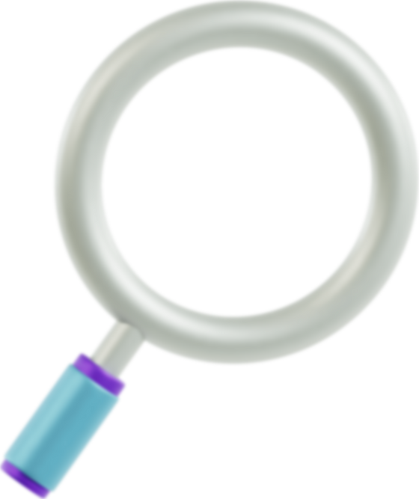

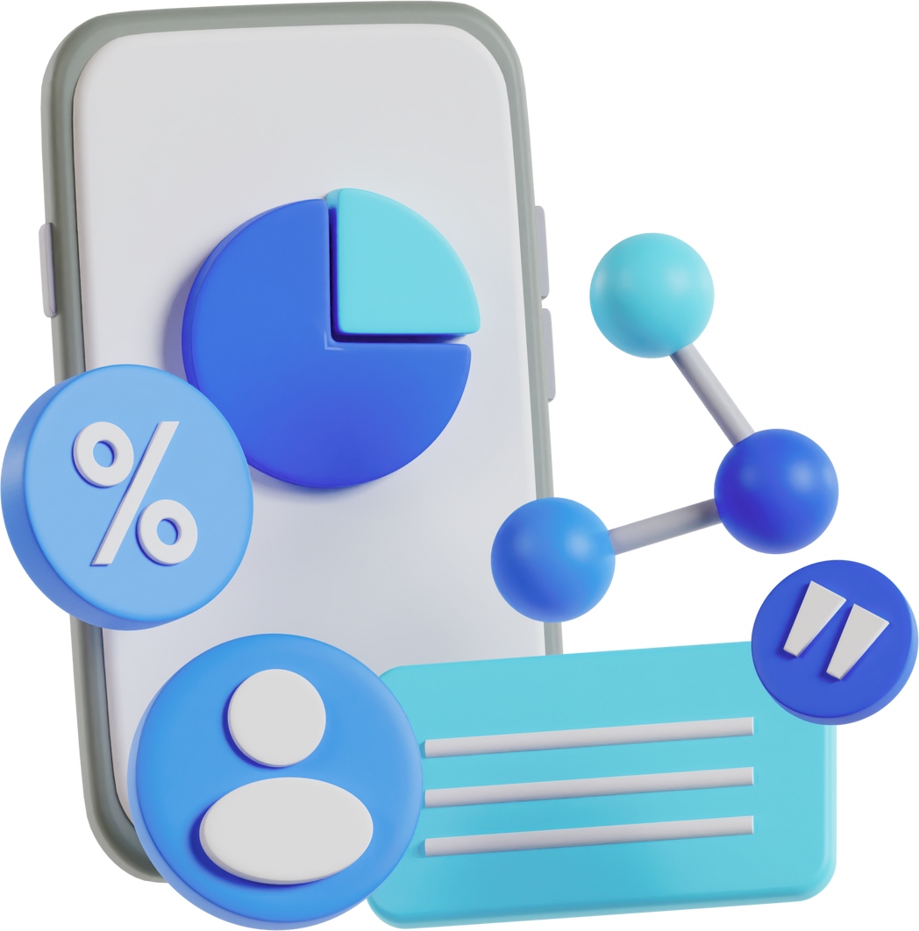
ONYX DNA
Marketing Performance
Overview
Prepared By: Amal Farouk

Slide 2

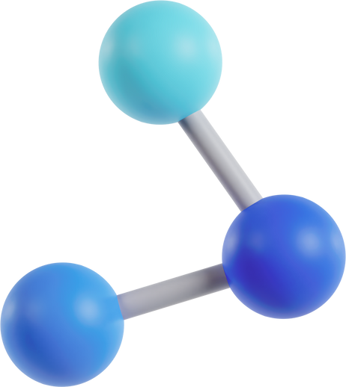

Metrics
Campaign (e.g., Spring)
Date and City/Location
Channel (e.g., Facebook), Device (e.g., Desktop), and Ad type
Impressions, CTR (%), Clicks, and Conversions
Cost and Revenue data, including Total Cost and Profit
Engagement metrics (Likes, Shares, Comments)
Social Media Objective
"Social media is not just an activity; it is an investment of valuable time and resources. Surround yourself with people who not just support you but inform your thinking."
Key Performance Indicators (KPIs)
Impressions
CTR (%)
Cost
Conversion Rate
Total Revenue
Profit

Slide 3
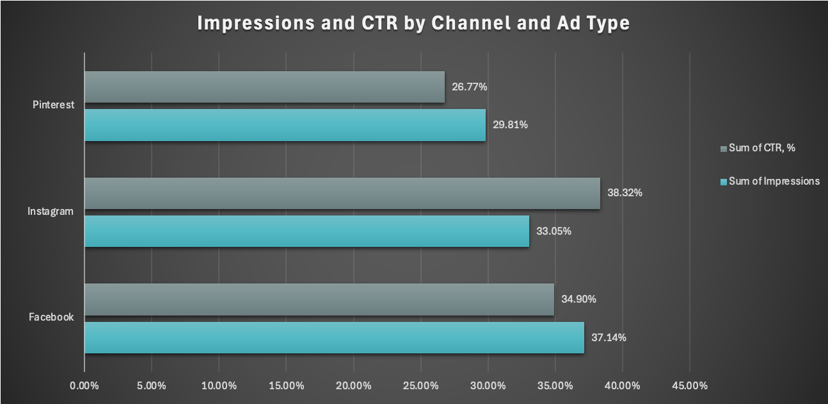
Impressions and CTR
Facebook has the highest impressions with 37.14% while Instagram leads in terms of CTR with 38.32%

Slide 4
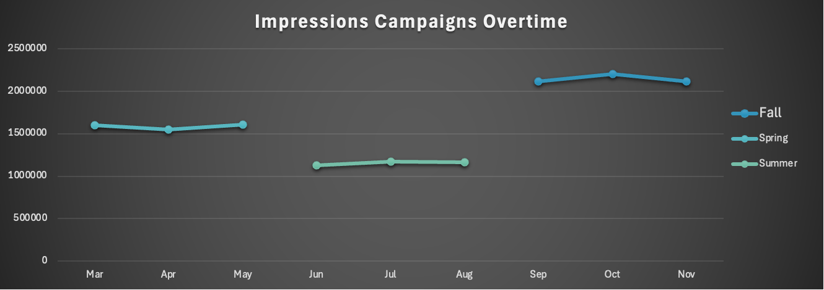
Impressions by Campaign
Impressions shows a high trend throughout the year with the lowest point in Spring and highest point in Fall

Slide 5
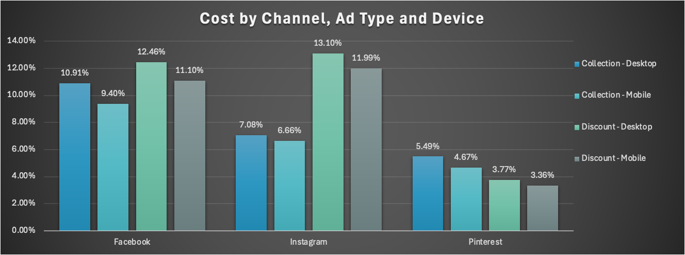
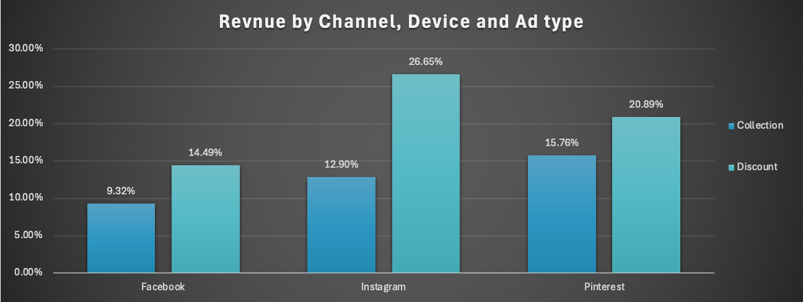
Cost VS Revenue
Facebook has the highest Ad spending with 44% of the budget while it only contributes to about 24% of the Revenue. Pinterest is the most effective Channel with 17% ad spending cost and contribute to 38% of the Revenue.

Slide 6
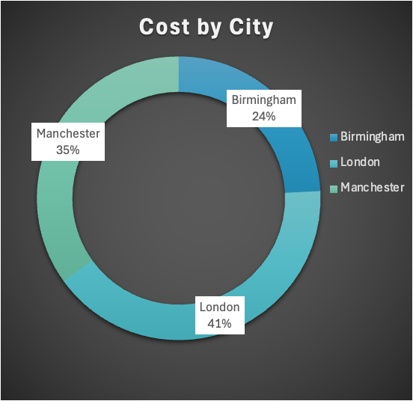
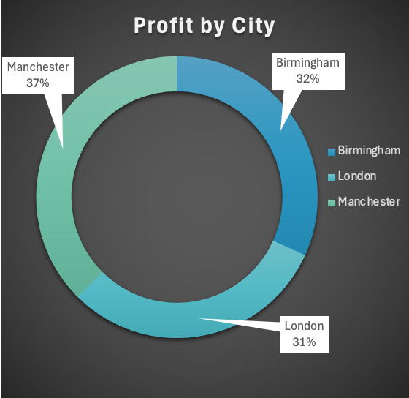
City Performance
London Leads in ad spending cost while it contributes to 31% of the profit. Birmengham is the most effective city with 24% of ad spending and 32% of the profit.

Slide 7
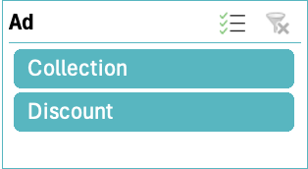
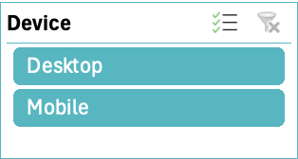
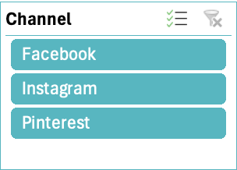
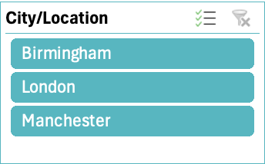

Slide 8




With this data in hand, we’re ready to fine-tune our approach and drive even greater success in upcoming campaigns.
Our Next Step
Step 1
Step 2
Step 3
Step 4
Increase the ad spending on pinterest and decrease it on Facebook
To push sales, Increase the proportion for the Discount type promotions
To attract more impressions, focus on Collection type promotions
Adjust the proportion of Fall campaign to ensure the impressions and sales remain stable throughout the year

